Slide 1

Our First Realtime Project On Make My Trip
COACH
Sundaralakshmi
MENTOR
Mary Vinolin Jayakumar Agnes
TRAINER
Parasakthi
TEAM MEMBERS
TEAM NAME: Hawkeyed Men On Mission
SRIRAM R (853102)
YUVAN SHANKAR N (853089)
VIGNESH KUMAR N (853126)
KALAYAPPAN S (851268)
SAKTHI GANESH (853121)
Caption: #Let’s make our trip with Make my trip

Slide 2

Goals of our Project
We mainly focus to Test the functionality of:
1. Booking one way outstation cab.
2. Booking round trip Flight.
3. Find Group Gifting in Gift Cards, fill card details & give invalid email to check the error message .
4. On the Hotel booking page, extract all the available numbers for Adult persons.

Slide 3





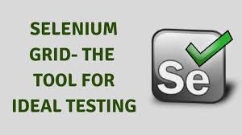
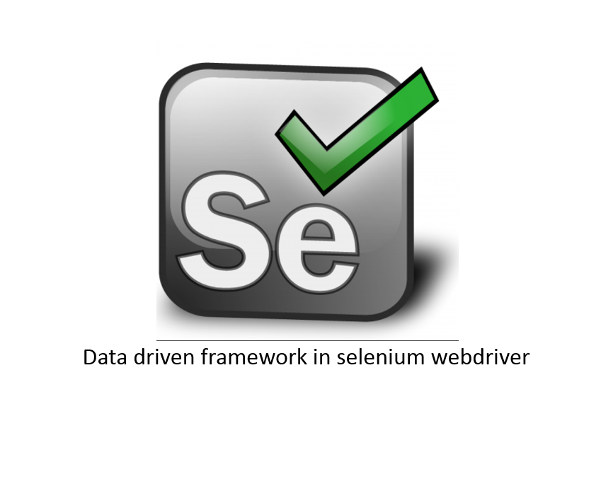

Components included in our project
Java |  | Hybrid Framework | POM + DataDriven
Selenium |  | Reports
POM |  | Jenkins
TestNG |  | Grid
Data Driven |  | Support Multiple Browsers

Slide 4
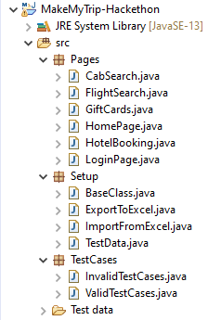
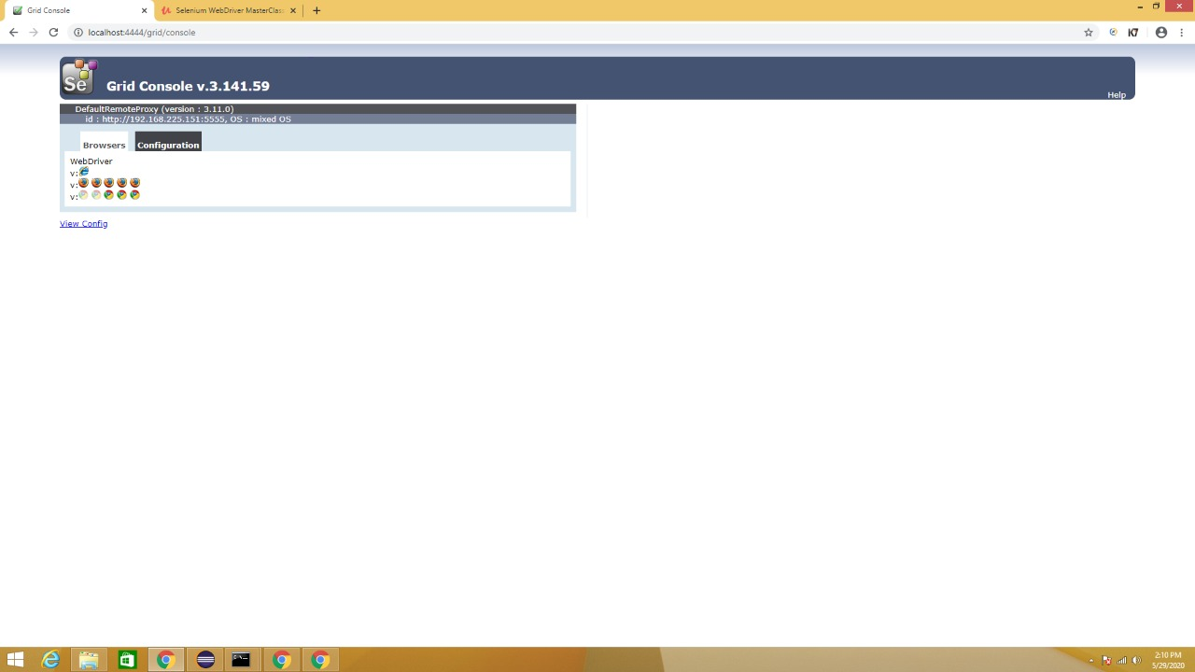
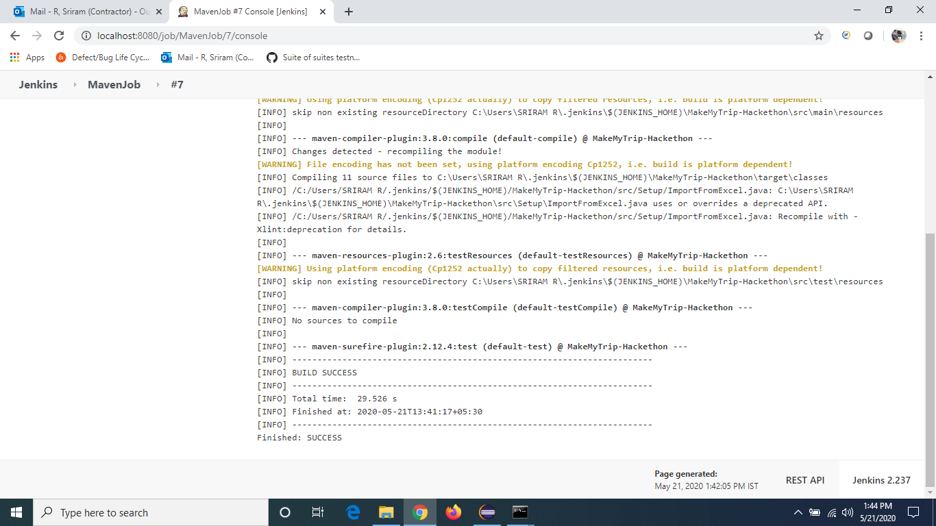
Special Add-ons to our Project…
Folder Structure
Selenium Grid
Jenkins
Proper folder structure for multiple programmers to work at the same time.
Implemented Grid to Run on multiple browsers on multiple OS at the same time.
Built our project using Jenkins.

Slide 5
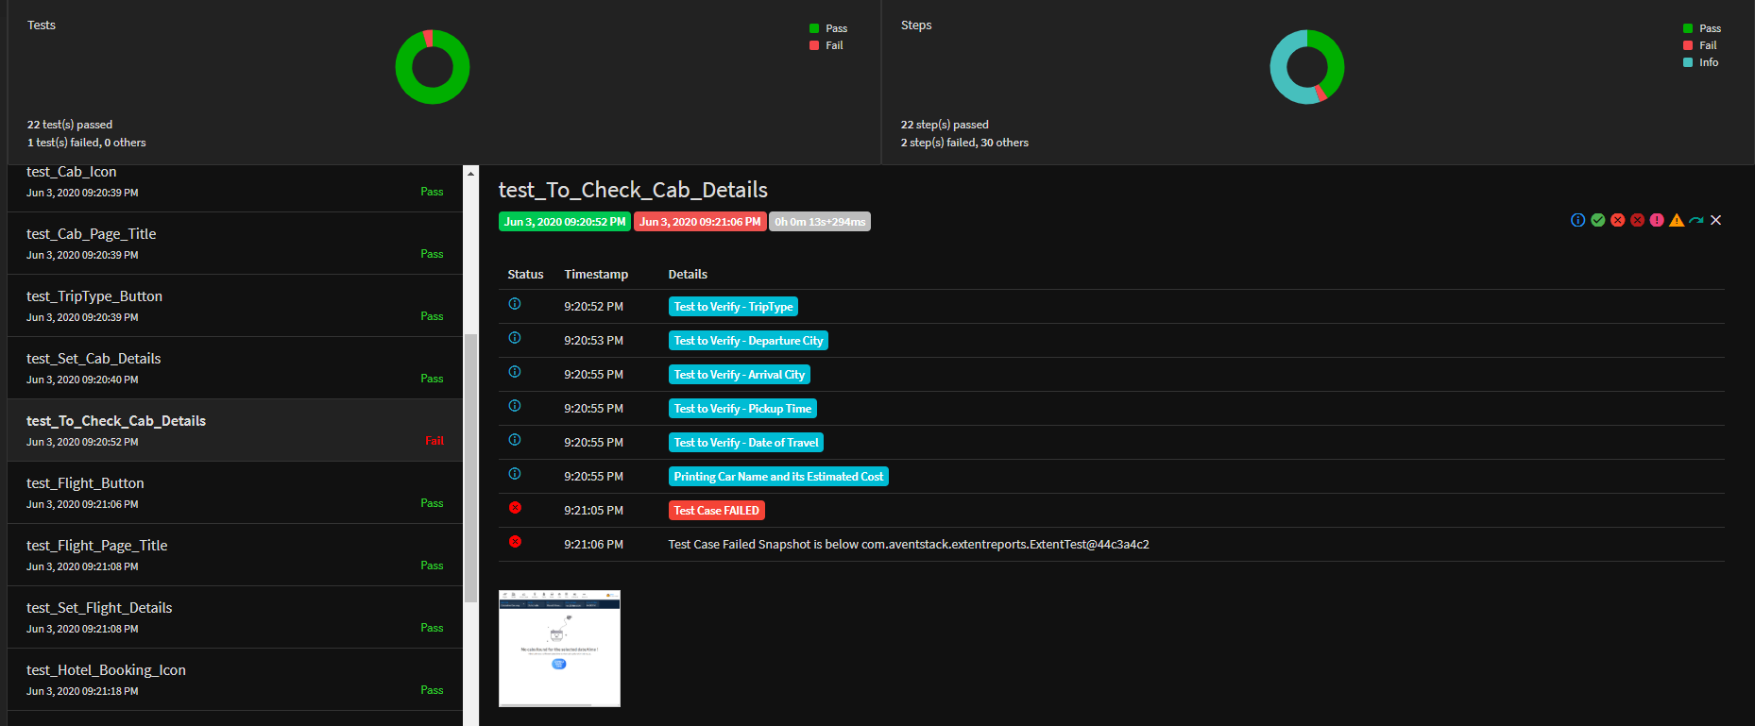
Step wise logger statements with attached screenshot in Extent Report.
Attached Screenshot with failure test cases

Slide 6
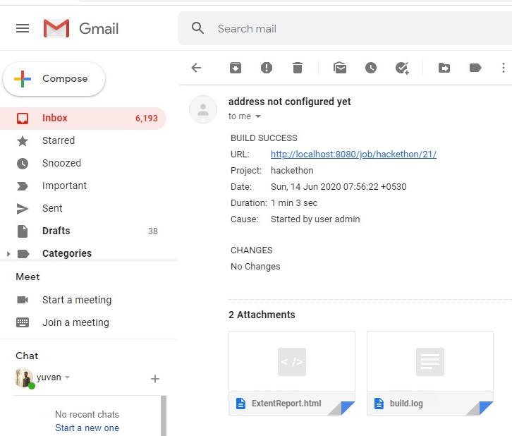
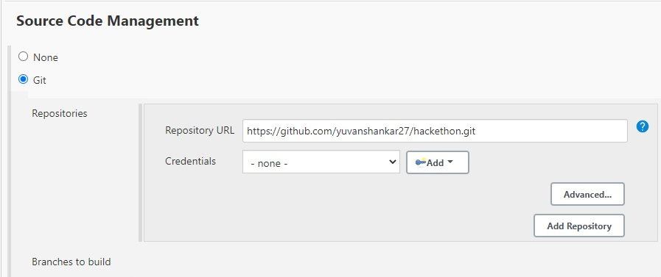
Special Add-ons to our Project…
Running the code from Github URL
Configured in Jenkins
Automated Mail with attached report
after every Jenkins Run

Slide 7
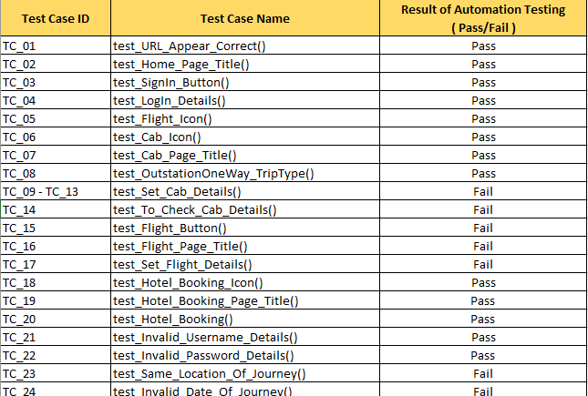
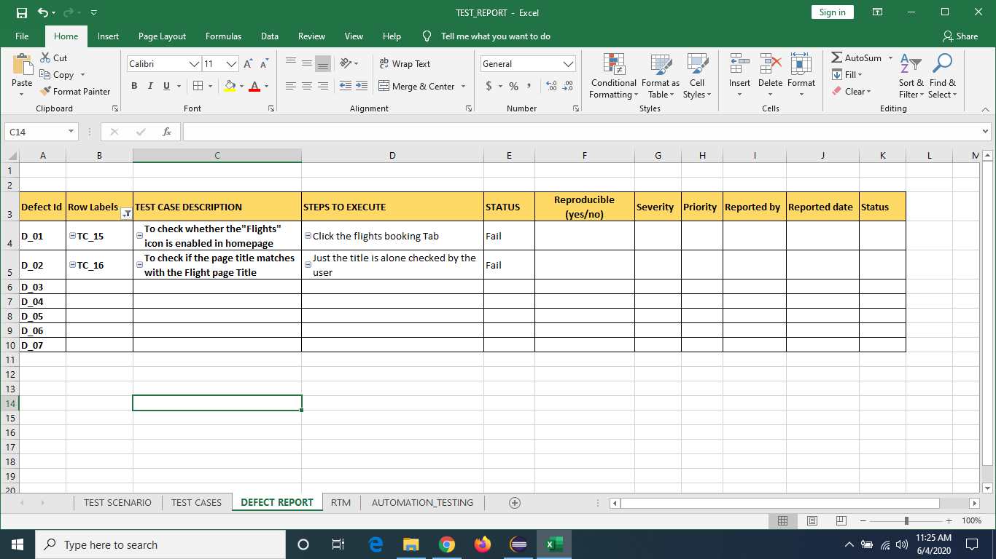
Special Add-ons to our Project…
Automatic Generation of Defect Log Report Based on the Failed Test cases
Automatic status update of Automation test report with Apache poi and V-look in excel.

Slide 8
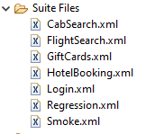
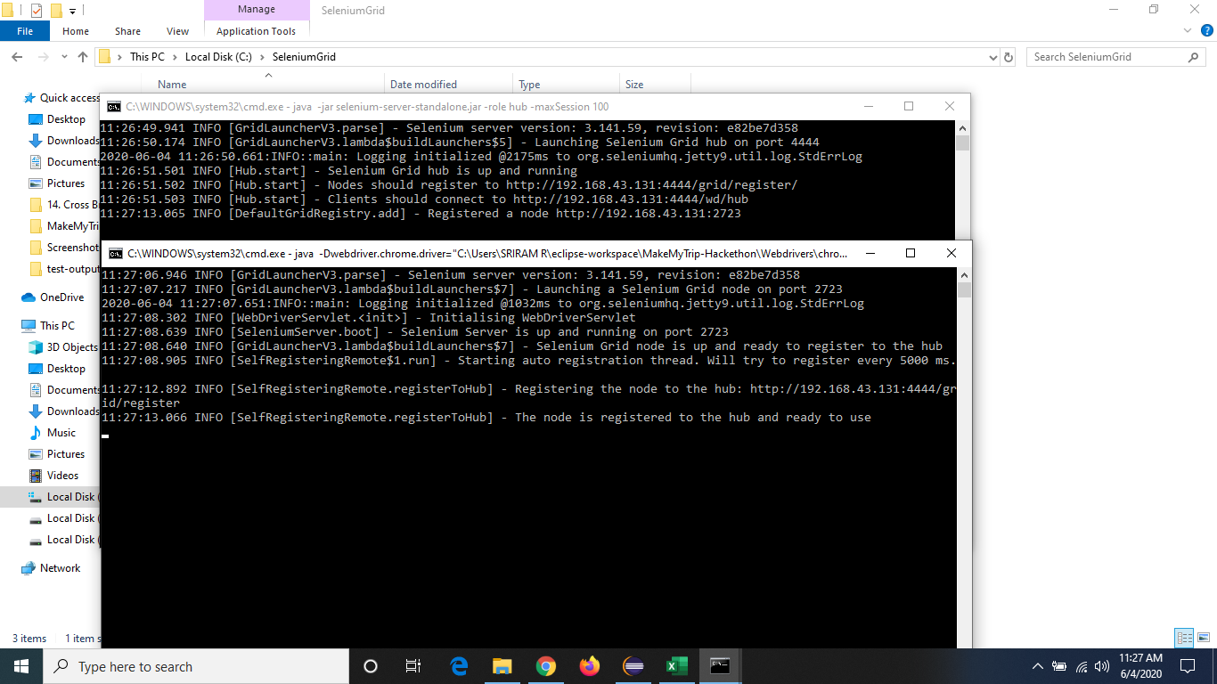
Special Add-ons to our Project…
Separate suite files to perform smoke, regression and page wise Testing.
Used Batch files for Multiple Node Generation in the hub itself during Grid Implementation

Slide 9
Special Add-ons to our Project…
Used Camel-Case Naming convention and Proper Comments to improve readability.
Used JS Executors at situations were selenium codes had chances of errors.
No static Sleep Statements and handled all delays with dynamic waits(Implicit , Explicit).
Used Maven for dependency management by not adding any external jars manually.
We have additionally tested the functionality of flight booking along with the given cab, hotel and gift card pages.
Used property files for login and browser selection(as instructed) and excel sheet to import other data.

Slide 10
Overcoming the Challenges..
Challenges we faced | How we Overcame it !
Element click intercepted by other elements. | Using Java Script Executors
How to wait till the elements are accessible without using Thread.sleep() | Using Explicit and Implicit wait statements
How to run a Grid without using another physical pc server | Using Batch Files to create Hub and Node
How to automatically update Test status in test report and defect log | Using apache-poi and V-look features.
How to make our project user-friendly | Use our readme.txt to Execute the test and Extent Report to understand the Test Results.

Slide 11
Things we learnt during this project
How to handle a dynamically changing Web Elements.
Proper time management in finishing weekly tasks.
How team work and coordination can help to handle situations.
How proper planning and work distribution can reduce time consumption.

Slide 12
Beyond Everything we got confidence that We can Learn anything when we work as a team and dedicated to it !..

